Slide 1
APPLIED PARASITOLOGY (APZ 401) LECTURE 3

Slide 2
HUMAN INTESTINAL NEMATODES
In tropical African countries these include
Ascaris lumbricoides,
Hookworms (especially Necator americanus and Ancylostoma duodenale),
Trichuris trichiura (whipworm),
Enterobius vermicularis (pinworm),
Strongyloides stercoralis.
Epidemiology:
Infection is rarely life-threatening and usually well tolerated.
Severity of disease is usually related to intensity of infection; light infections usually well-tolerated (even in patients with compromised nutrition).

Slide 3
Global burden of intestinal nematode infections (World Health Organization, 2002)
Helminth | No infected (millions) | Morbidity cases (millions) | Mortality/year (thousands)
Ascaris lumbricoides | 1450 | 350 | 60
Hookworms | 1300 | 150 | 65
Trichuris trichiura | 1050 | 220 | 10
NOTE:
Estimations for some human intestinal nematodes.
Disability Adjusted Life Years (DALY) lost for intesinal nematodes estimated to be 39 million.

Slide 4
HUMAN INTESTINAL NEMATODES (contd.)
The infections have disappeared from Europe and North America, and have been successfully controlled in many Asian countries.
In many developing countries, the total burden of disease has since increased; due to urbanization and population growth.
The infections mainly occur in the poorest section of endemic communities; this aggravates poverty and social deprivation.
Clinical features
Ascaris:
High-intensity infections are associated (along with other intestinal nematodes) with stunting of linear growth.
Pulmonary migration of larvae may cause
pneumonia (usually self-limiting)

Slide 5
HUMAN INTESTINAL NEMATODES (contd.)
fever,
dyspnoea (difficulty in breathing),
asthma (associated with eosinophilia).
Intestinal ascariasis may cause
vague abdominal pains,
intestinal obstruction,
hepatobiliary and pancreatic system obstruction.

Slide 6
HUMAN INTESTINAL NEMATODES (contd.)
Hookworms:
Gut invasion may cause, e.g.
abdominal pain,
nausea,
anorexia (loss of appetite).
Anaemia results; due to the hookworms taking up blood meals.
Intellectual impairment (as in other intestinal nematode infections).
Improvement in cognitive function has been associated with effective treatment with albendazole.

Slide 7
HUMAN INTESTINAL NEMATODES (contd.)
Trichuris:
Well-nourished patients tolerate small number of adult worms.
Heavy infections cause Trichuris-dysentery syndrome; characterized by
chronic diarrhoea,
anaemia,
growth retardation.
Mucus found in stool; usually with blood.
Rectal prolapse (descent) is a well-known symptom.

Slide 8
HUMAN INTESTINAL NEMATODES (contd.)
Diagnosis:
Direct faecal smear.
Floatation techniques.
Kato-Katz technique.
Formol-Ether concentration technique.
Prevention and control:
Diagnosis & antihelminthic treatment.
Personal hygiene; e.g. fruit & vegetable washing, avoiding finger-nail nibbling, regular hand-washing.

Slide 9
HUMAN INTESTINAL NEMATODES (contd.)
Avoidance of indiscriminate defaecation.
Provision of functional toilet facilities.
Avoidance of walking barefooted.
Protection of food & water from contamination.

Slide 10
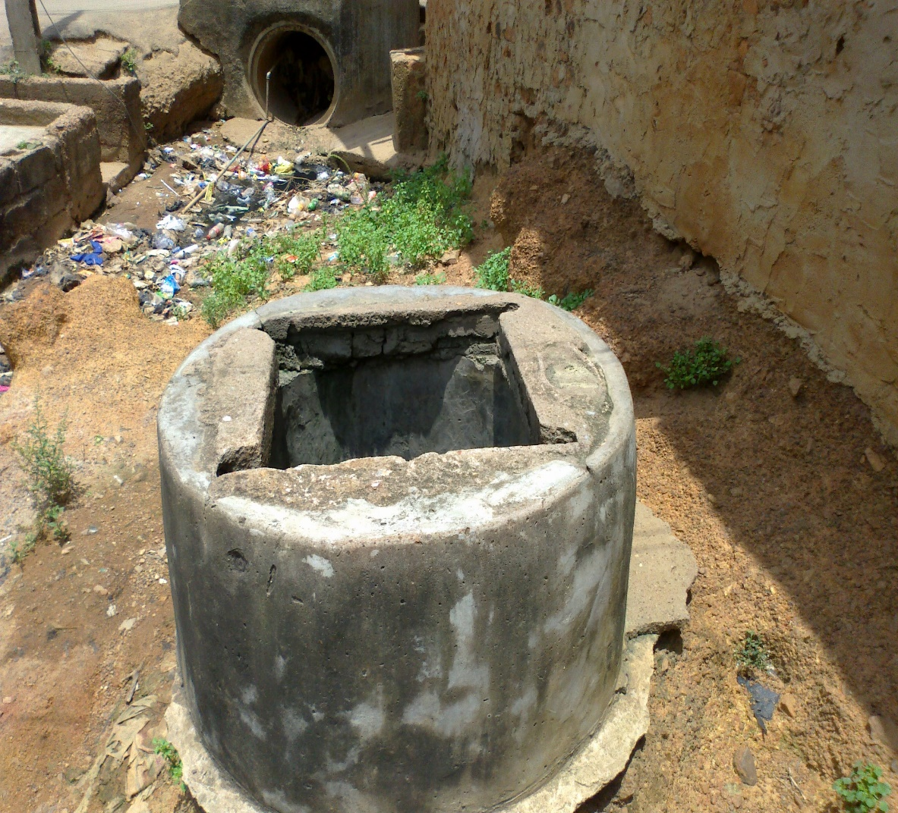
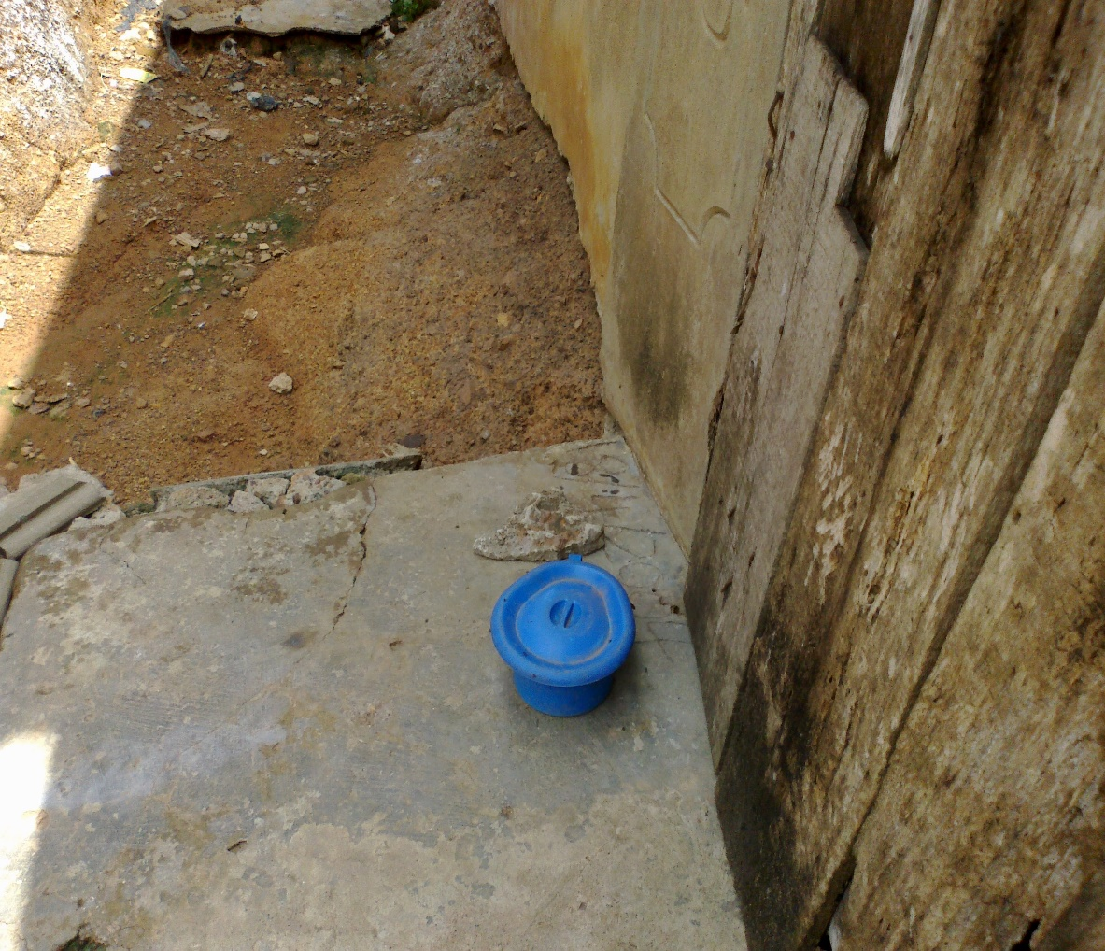
HUMAN INTESTINAL NEMATODES (contd.)
Chamber pot containing faeces near an unprotected well.
Unprotected well near dirty gutter.

Slide 11
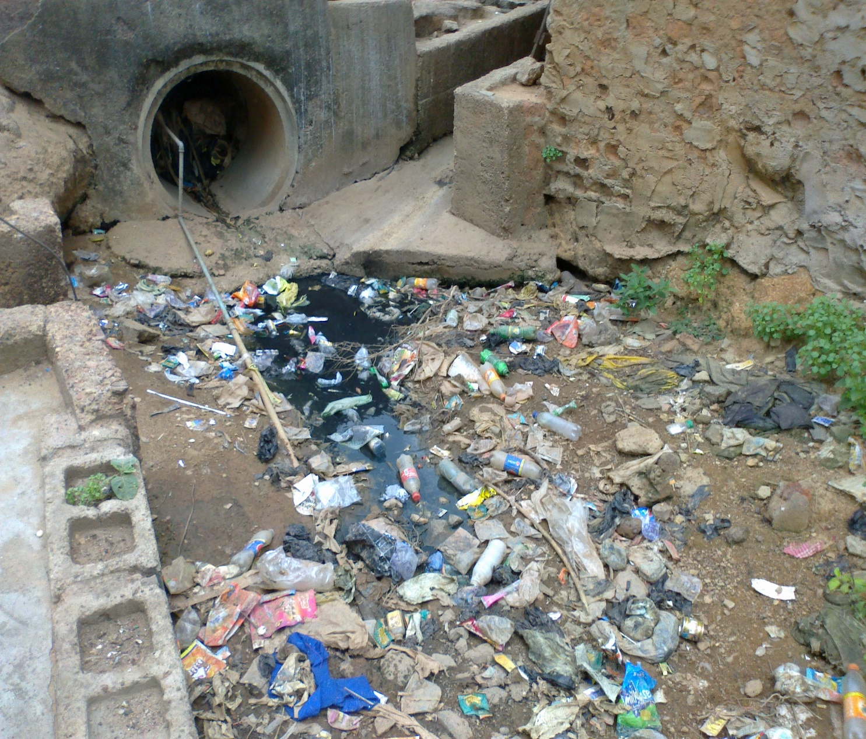
Gutter with refuse
NOTE:
Situated near an unprotected well and a faeces-loaded chamber pot.
Water pipe runs through the gutter.
Field observations showed that the gutter is often a dump site for human faeces.

Slide 12
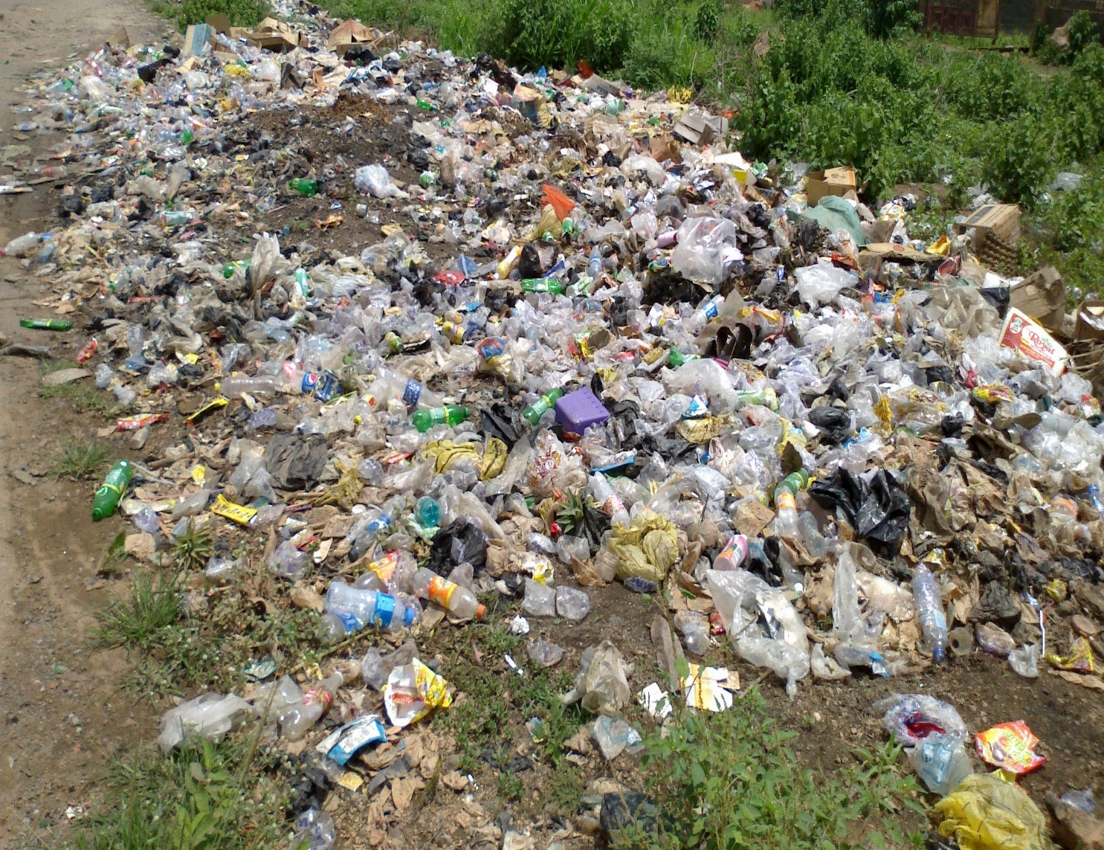
A dump site
NOTE:
Many defaecate on dump sites.
Walking barefooted on such sites may enhance hookworm transmission.

Slide 13
CRYPTOSPORIDIOSIS
Causative agent & life cycle:
Caused by Cryptosporidium species, e. g. C. parvum.
Widespread in developing countries, South Africa, Europe, & North America.
Infection occurs in rodents, fowl, rhesus monkey, cattle & other herbivores, & humans.
The parasite inhabits the mucosal epithelial cells of gastrointestinal tract; particularly surface of villi of lower small intestine.

Slide 14
CRYPTOSPORIDIOSIS (contd.)
Clinical findings:
Main clinical feature is diarrhoea.
The diarrhoea is self-limited (1-2 weeks) in normal persons.
The diarrhoea may be severe & prolonged in
very young individuals,
old individuals,
immunocompromised individuals.

Slide 15
CRYPTOSPORIDIOSIS (contd.)
Diagnosis:
Stool concentration techniques; using modified acid-fast stain.
Monoclonal antibody.
Fluorescent microscopy.
ELISA; to detect faecal antigen.

Slide 16
CRYPTOSPORIDIOSIS (contd.)
Epidemiology & control:
Though widespread, but generally asymptomatic.
Humans with low or compromised immunity are at high risk; need adequate caution.
Infection is acquired from
infected animal or human faeces,
faeces-contaminated food or water.
Outbreak can result from inadequate protection, treatment, or filtration of public water supplies.

Slide 17
INSECT VECTORS OF PARASITIC DISEASES
Examples of insect vectors:
Anopheles;
Culex;
Simulium;
Glossina;
Chrysops;
Culicoides.
Personal protection methods:
Untreated bednets.

Slide 18
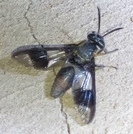
Chrysops (deer fly)
NOTE:
Vector of Loa loa

Slide 19
INSECT VECTORS OF PARASITIC DISEASES (contd.)
Impregnated nets; particularly Long-Lasting Impregnated Nets (LLINs).
LLINs are important in malaria control.
Results in reduction in insecticide spraying.
Each LLIN is a ready-to-use pretreated mosquito net.
Requires no further treatment for 4 to 5 years.
LLINs ward off mosquitoes.
LLINs kill any mosquitoes that make contact with them.
Users are protected against mosquito bites.

Slide 20
INSECT VECTORS OF PARASITIC DISEASES (contd.)
Impregnated curtains.
Smokes & vapours.
Repellents.

